Slide 2
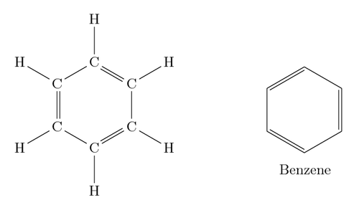
What is Benzene ?
Benzene is an organic compound with the molecular formula C₆H₆. benzene is a colorless and highly flammable liquid with a sweet smell and a relatively high melting point.

Slide 3
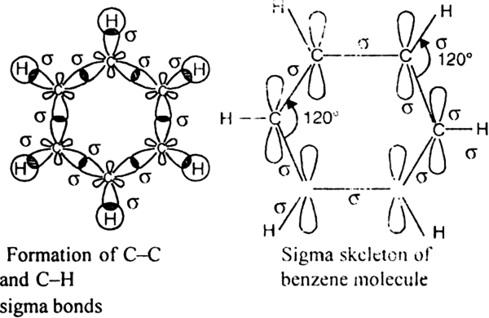
Molecular orbital structure of benzene

Slide 4
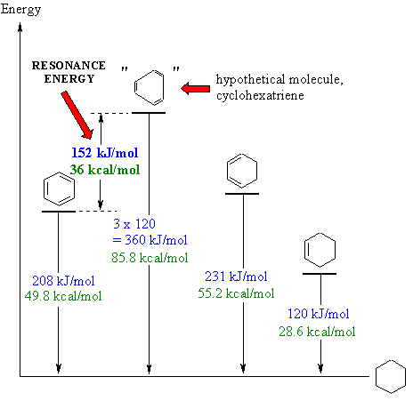
Resonance energy of benzene

Slide 5
Resonance of benzene
The oscillating double bonds in the benzene ring are explained with the help of resonance structures as per valence bond theory. All the carbon atoms in the benzene ring are sp2 hybridized. One of the two sp2 hybridized orbitals of one atom overlaps with the sp2 orbital of adjacent carbon atom forming six C-C sigma bonds. Other left sp2 hybridized orbitals combine with s orbital of hydrogen to form six C-H sigma bonds. Remaining unhybridized p orbitals of carbon atoms form π bonds with adjacent carbon atoms by lateral overlap.

Slide 6
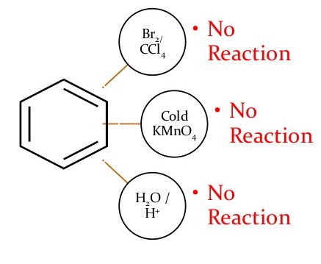
Benzene does not behave like alkenes alkynes

Slide 7
Physical properties
Benzene is immiscible in water but soluble.
It is a colourless liquid and has an aromatic odour.
It has a density of 0.87g cm-3. It is lighter than water.
Benzene has a moderate boiling point and a high melting point. (Boiling point: 80.5°C, Melting point: 5.5°C)
Benzene shows resonance.
It is highly inflammable and burns with a sooty flame.

Slide 8
Aromaticity of benzene
Benzene is an aromatic compound, as the C-C bonds formed in the ring are not exactly single or double, rather they are of intermediate length. Aromatic compounds are divided into two categories: benzenoids (one containing benzene ring) and non-benzenoids (those not containing benzene ring), provided they follow Huckel rule. According to Huckel rule, for a ring to be aromatic it should have the following property:
Planarity
Complete delocalization of the π electrons in the ring
Presence of (4n + 2) π electrons in the ring where n is an integer (n = 0, 1, 2, . .)

Slide 9
Preparation of Benzene
Some basic methods for preparation of benzene are
Preparation of benzene from alkynes
Preparation of benzene from aromatic acids
Preparation of benzene from phenol
Preparation of benzene from sulphonic acids

Slide 10
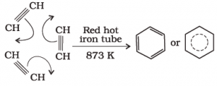
Preparation of benzene from alkynes
Benzene is prepared from ethyne by the process of cyclic polymerization. In this process, Ethyne is passed through a red hot iron tube at 873 K. The ethyne molecule then undergoes cyclic polymerization to form benzene.

Slide 11
Preparation of benzene from aromatic acids
Benzene can be prepared from aromatic acids through decarboxylation reaction. In this process, sodium salt of the benzoic acid (sodium benzoate) is heated with soda lime to produce benzene along with sodium carbonate.

Slide 12
Preparation of benzene from phenol
Benzene can be prepared from phenols too through their reduction. In this process vapors of phenol are passed over heated zinc dust. Zinc dust reduces them to form benzene.

Slide 13
Preparation of benzene from sulphonic acids
Benzene can be prepared from sulphonic acids through their hydrolysis. In this process Benzene sulphonic acid is exposed to superheated steam leading to the formation of benzene.
C₆H₅-SO₃H + H₂O → C₆H₆ + H₂SO₄

Slide 14
Uses of Benzene
Benzene is used in various industrial processes such as in the manufacture of lubricants, plastics, rubbers, dyes, synthetic fibres, etc. However, it has non-industrial uses too which are limited due to the reason benzene is toxic and carcinogenic. The different uses of Benzene are mentioned below.
Benzene is used in the preparation of phenol. It is also used to prepare aniline used in dyes and in dodecylbenzene used for the detergents.
In early times, benzene was used in degreasing of metal.
It is used for manufacturing of nylon fibres.
The main use of benzene is that it is used in the manufacture of other chemicals such as ethylbenzene, cyclohexane, cumene, nitrobenzene, alkylbenzene, etc.

