Slide 1
CHANGES AND SHIFTS IN INDIAN POLITICS FROM 1947-2019
Class:- M.A. 1st Semester
Subject:- Indian Politics: Institutions at Work
Name of Teacher:- Rajni Bala
Designation:- Assistant Professor
Department:- Political Science

Slide 2
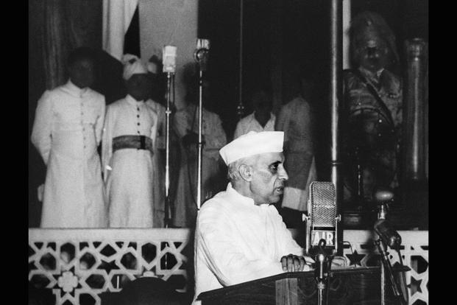
1947: India gains independence from British rule.

Slide 3
1947: India fights first war with Pakistan after Pakistani tribesmen supported by the army invade Jammu and Kashmir.

Slide 4
1948: Mahatma Gandhi is assassinated by Nathuram Godse.

Slide 5
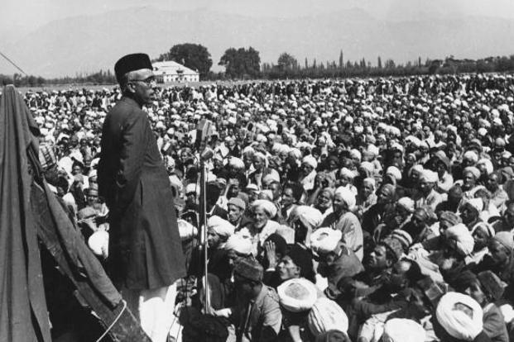
1948: Indian troops enter the Nizam-ruled princely state of Hyderabad under Operation Polo and annex the state. 1949: The Indian Constituent Assembly adopts Article 370 of the Constitution,ensuring special status and internal autonomy for Jammu and Kashmir.

Slide 6
1951: Prime Minister Jawaharlal Nehru introduces India’s first five-year plan, which defines the Nehruvian model of centralized economic planning and development. The Soviet-style five-year plan also creates a typically Indian model of mixed economy and big government.

Slide 7
1954: Jammu and Kashmir’s accession to India is ratified by the state’s constituent assembly 1956: Second five-year plan presented, with a focus on rapid industrialization. 1957: Jammu and Kashmir approves its own constitution, modelled on the lines of India’s. 1959: The Dalai Lama escapes to India. India’s sheltering of the Tibetan spiritual leader is seen as a trigger for the 1962 war with China.

Slide 8
1960: Bombay state is split along linguistic lines, forming Maharashtra and Gujarat, after a series of violent protests. 1961: Indian Army liberates Goa from the Portuguese; it becomes a Union Territory. 1962: French-ruled Pondicherry (now Puducherry) becomes part of India as a Union Territory.
1962: China’s People’s Liberation Army invades India in Ladakh, and across the McMahon Line in the then North-East Frontier Agency (now Arunachal Pradesh),inflicting heavy damage on Indian forces.
1964: Jammu and Kashmir National Liberation Front floated to launch an armed struggle for an independent and unified Kashmir.
1965: India’s second war with Pakistan over Kashmir .
1966: Punjab is divided into three states along linguistic lines—Haryana, Himachal Pradesh and Punjab
1967: Laying the foundation of the Green Revolution, farmers harvest the first crop of high-yielding wheat

Slide 9
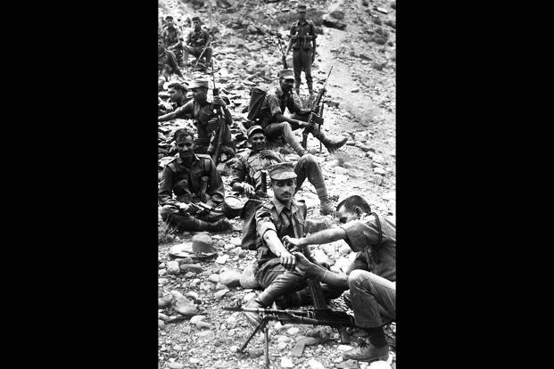

Slide 10
1967: Armed peasant revolt in Naxalbari in the Darjeeling district of West Bengal gathers momentum. 1969: Indian Space Research Organisation (Isro) founded
1969: Government nationalizes 14 major Indian scheduled commercial banks to serve the needs of development.
1970: Meghalaya is formed as an autonomous state within Assam in 1970. It becomes a separate state in 1972 with Shillong as its capital under the North Eastern Areas (Re-organisation) Act,1971. The Act subsequently creates the states of Manipur, Tripura, Mizoram, Arunachal Pradesh and present-day Assam.

Slide 11
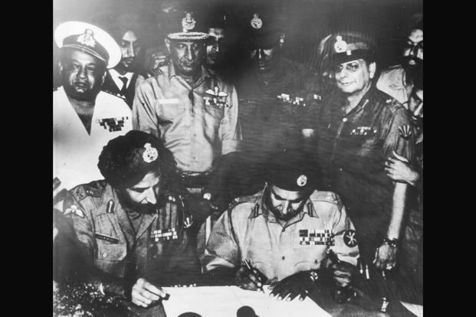
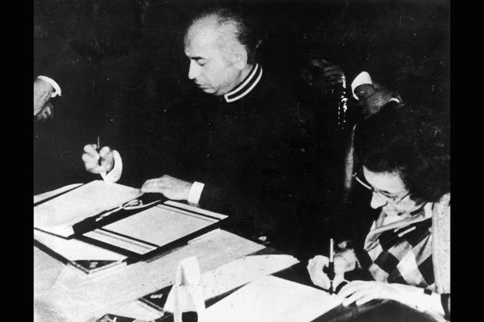
1971: India fights third war with Pakistan from Pakistan and Bangladesh is born as an independent nation. 1972: India and Pakistan sign the Simla Pact, under which the two sides agree to sort out differences and disputes ; East Pakistan breaks away bilaterally

Slide 12
1974: India conducts peaceful nuclear test at Pokhran, comes under international sanctions.

Slide 13
1975: The Congress government imposes Emergency.

Slide 14
1975: Socialist leader Jayaprakash Narayan leads the anti-Emergency movement. 1977: Emergency ends, first non-Congress government elected at the centre. 1980: The BJP is formed after internal differences in the Janata Party result in the collapse of the Janata government in 1979. 1980: Sixth five-year plan marks the beginning of economic reforms. 1983: N.T. Rama Rao-led Telugu Desam Party forms government in Andhra Pradesh for the first time.

Slide 15
1984: Operation Blue Star is launched to drive out the Sikh extremist religious leader Jarnail Singh Bhindranwale and his armed followers from the premises of the Golden Temple in Amritsar. 1984: Prime minister Indira Gandhi assassinated by two of her Sikh bodyguards.

Slide 16
1984: More than 3,500 people die and 500,000 are injured in the Bhopal Gas Tragedy following the leakage of toxic methyl isocyanate from Union Carbide India Ltd’s pesticide plant in the city 1987: India-Sri Lanka pact signed to establish peace and normalcy in Sri Lanka after tensions between majority Sinhala and minority Tamils. India deploys troops in Sri Lanka to ensure peace.
1988: Prime minister Rajiv Gandhi visits China and meets Deng Xiaoping—the first visit to China by an Indian prime minister in 34 years; they agree to set up a joint working group to ensure peace in the border areas and make concrete recommendations for overall resolution of the boundary question within a definite time frame.
1989: Outbreak of militancy in Jammu and Kashmir.
1989: Exodus of Kashmiri Pandits from Jammu and Kashmir
1990: Cauvery tribunal formed to resolve 150-year-old river water dispute between Karnataka and Tamil Nadu.

Slide 17
1990: V.P. Singh government tables Mandal Commission recommendations for 27% reservation for OBC candidates in all levels of government services.
1991: Economic liberalization opens the economy to foreign and private investment.
1992: The Babri Masjid in demolished
1993: Series of bomb blasts in Bombay (now Mumbai).
1998: India conducts five nuclear tests, joins club of countries possessing nuclear weapons. Pakistan tests six atomic weapons in response.

Slide 18
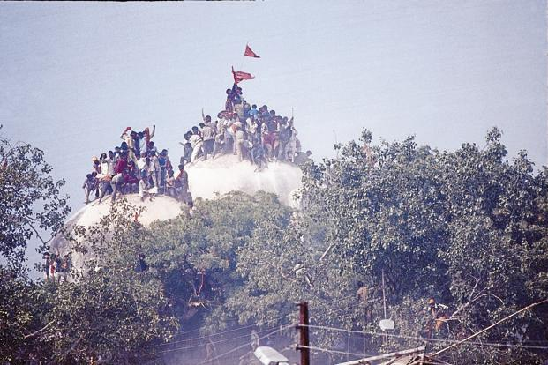
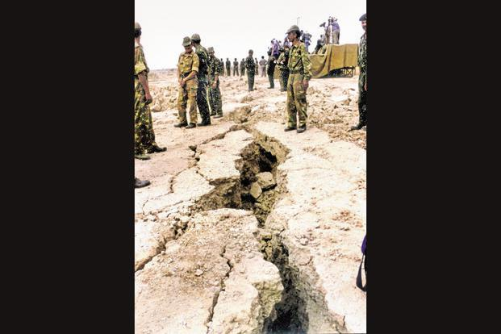

Slide 19
1999: Prime Minister Atal Bihari Vajpayee visits Lahore in the inaugural run of the Delhi-Lahore bus. The two countries sign Lahore pact committing both to bilateral dispute resolution.
1999: Delhi-bound Indian Airlines flight IC-814 hijacked from Kathmandu to Kandahar in Afghanistan by Harqat-ul-Ansar. After a week’s negotiations with the Indian government, militants Maulana Masood Azhar, Syed Umar Sheikh and Mushtaq Latram Jerger released in exchange for the hostages.
1999: Indian army evicts Pakistani army regulars and militants from the heights of Kargil inside the Line of Control in Kashmir.
2000: The states of Uttarakhand, Chhattisgarh and Jharkhand are formed.
2001: Five terrorists of Lashkar-e-Taiba and Jaish-e-Mohammed storm Indian Parliament.
2002: Communal violence breaks out in Gujarat after a coach of Sabarmati Express is set on fire at Godhra railway station.

Slide 20
2005: Right to Information Act implemented.
2006: National Rural Employment Guarantee Act, 2005, implemented.
2008: Ten members of Lashkar-e-Taiba carry out a series of coordinated shooting and bombing attacks at different locations, including Taj hotel, in Mumbai.
2010: Unique Identification Authority of India issues the first Aadhaar card to Ranjana Sonawne, a resident of Tembhli village in Nandurbar district of Maharashtra.
2011: India Against Corruption movement launched against Congress-led United Progressive Alliance (UPA) government.
2011: World’s longest running democratic Left rule comes to an end as Mamata Banerjee defeats communists in West Bengal, riding on the success of an anti-land acquisition movement.
2014: The BJP wins a parliamentary majority for the first time, under the leadership of Narendra Modi; BJP-led National Democratic Alliance forms government.

Slide 21
2014: India’s 29th state, Telangana, is created. Telangana Rashtra Samithi (TRS) forms the first government in the state.
2014: The Pradhan Mantri Jan Dhan Yojana, the government’s flagship financial inclusion programme, is launched.
2015: India invites US president Barack Obama to be the chief guest at Republic Day parade, the first time a US president is invited for the event
2016: Pradhan Mantri Ujjwala Yojana (PMUY) launched to provide LPG connections to women below the poverty line without upfront charges.

Slide 22
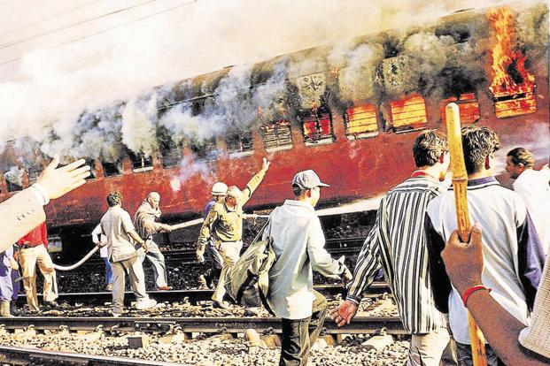
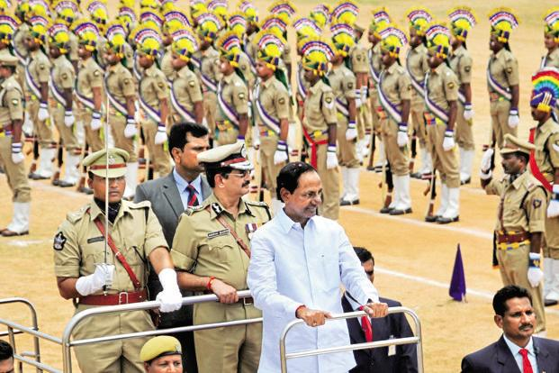
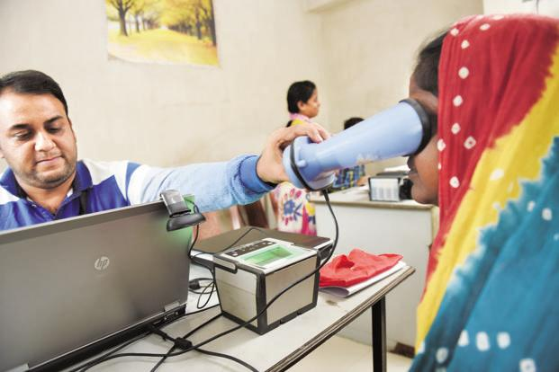

Slide 23
END

