Slide 3
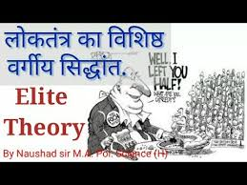

Slide 4
THEORIES OF DEMOCRACY
1.THE CLASSICAL LIBERAL THEORY OF DEMOCRACY
2.THE ELITIST THEORY OF DEMOCRACY
3.THE MARXIAN THEORY OF DEMOCRACY

Slide 6
MEANING OF ELITE
ELITE IS TAKEN FROM THE WORD “ELIGERE”. WHICH MEANS “SELECTION BY CHOICE”

Slide 7
DEFINITIONS OF ELITE
“ELITES ARE THOSE GROUPS WHICH EMERGE TO POSITION OF LEADERSHIP AND INFLUENCE AT EVERY SOCIAL LEVEL”_G.D.H.COLE

Slide 8
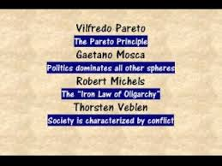
MAIN SUPPORTER OF ELITE THEORY
VILFRED PARETO,G.MOSCA,ROBERT MICHELS,LASWELL,G.D.H.COLE

Slide 9
VIEWS OF VILFREDO PARETO
SOCIETY
HIGHER STRATUM
LOWER STRATUM

Slide 10
VIEWS OF VILFREDO PARETO
ELITE
NON-GOVERNING ELITE
GOVERNING ELITE

Slide 11
VIEWS OF VILFREDO PARETO
GOVERNING ELITE
LIONS
FOXES

Slide 12
VIEWS OF G.MOSCA
RULLING CLASS
RULLED CLASS

Slide 13
VIEWS OF G.MOSCA
RULLING CLASS
RULLED CLASS

Slide 14
VIEWS OF ROBERT MICHELS
IRON LAW OF OLIGARCHY
PROFESSIONAL POLITICIANS

Slide 15
VIEWS OF C.WRIGHT MILLS
POWER ELITE
MILITARY OFFICERS,INDUSTRIALIST,RELIGIOUS LEADERS,MERCHANT,ADMINISTRATIVE OFFICERS,

Slide 17
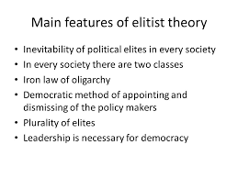
GOVERNMENT OF THE AND BY THE PEOPLE IS A MERE MYTH
IN DEMOCRACY ELECTION ARE ELECTION OF ELITES
NON-PARTICIPATION OF PEOPLE IN POLICY MAKING
CIRCULATION OF ELITES
FAITH IN THE GOVERNMENT BY EXPERTS AND NOT BY THE PEOPLE
NO SPECIAL IMPORTANCE IS GIVEN TO IDEOLOGY
RECOGNITION TO INEQUALITY

Slide 18
CRITICISM OF ELITE THEORY 1.LACK OF FAITH IN COMMON PEOPLE. 2.IT IS CONSERVATIVE THEORY. 3.ELITE CANNOT MAINTAIN EQUILLIBRIUM IN SOCIETY. 4.THIS THEORY IS SILENT ABOUT DEMOCRATIC SOCIETY. 5. THIS THEORY GIVES NO IMPORTANCE TO IDEOLOGY.

Slide 19
6.THIS THEORY GIVES NO IMPORTANCE TO INDIVIDUAL. 7.LEADERS ARE GIVEN UNDUE IMPORTANCE. 8.THIS THEORY DOES NOT GIVE DUE IMPORTANCE TO PUBLIC OPINION. 9.THIS THEORY IS AGAINST THE PRINCIPLE OF SOCIAL AND POLITICAL EQUALITY. 10.WHAT SHOULD BE THE BASIS OF POLITICAL ELITE?

Slide 20
E.g. OF ELITE CLASS OF INDIA
GANDHI FAMILY

Slide 21
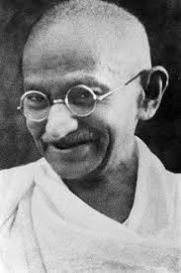
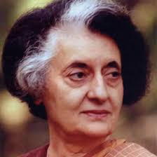
ELITE CLASS OF INDIA
MAHATMA GANDHI
INDIRA GANDHI

Slide 22
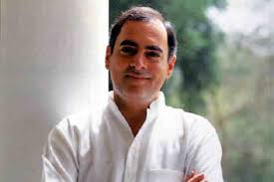
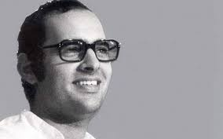
ELITE CLASS OF INDIA
RAJIV GANDHI
SANJAY GANDHI

Slide 23
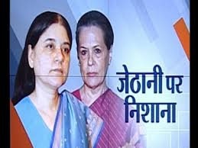
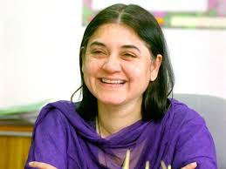
ELITE CLASS OF INDIA
SONIA GANDHI
MENAKA GANDHI

Slide 24
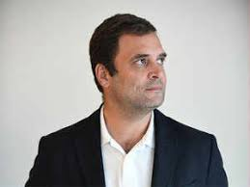
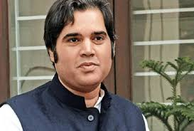
ELITE CLASS OF INDIA
RAHUL GANDHI
VARUN GANDHI

Slide 25
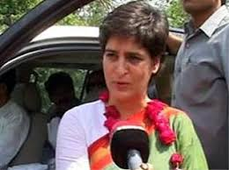
PRIYANKA GANDHI
ELITE CLASS OF INDIA

